Slide 1
Growing a Decision
Trees

Slide 2
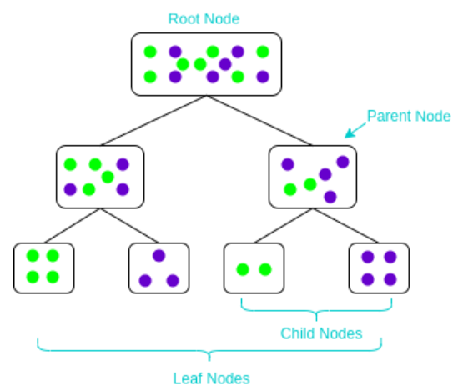
Decision Tree Recap

Slide 3
Node splitting in a Decision Tree?
Node splitting is the process of dividing a node into multiple sub-nodes to create relatively pure nodes.
Node splitting can be broadly classified into 2 types, based on target variables.

Slide 4
Node splitting Types :
Regression problems (Target variable is Continuous)
Reduction in Variance
Classification problems (Target variable is Discrete)
Entropy / Information Gain
Gini Impurity

Slide 5
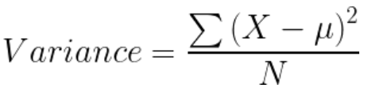
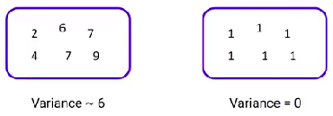
Reduction in Variance:
Method of splitting the node when the target variable is continuous.
If a node is entirely pure, then the variance is zero.

Slide 6
Steps to calculate variance of a split:
Calculate the variance of each child node.
Calculate the variance of each split as weighted average variance of each child node.
Select the split with the lowest variance.
Perform steps 1-3 until completely pure nodes are achieved.

Slide 7
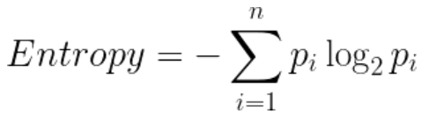
Information Gain
Information Gain is used for splitting the nodes when the target variable is categorical.
IG = 1 - Entropy
Entropy is used for calculating the purity of a node.
Lower the value of entropy, higher is the purity of the node.

Slide 8
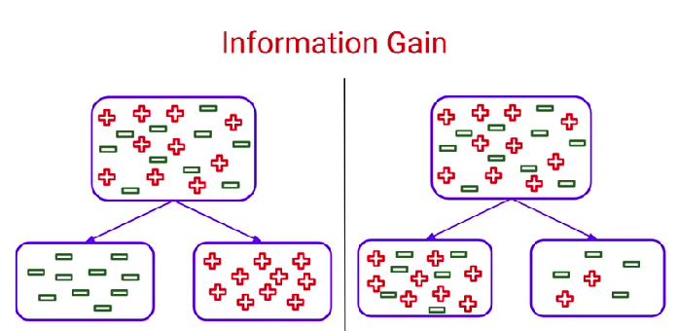
Information Gain

Slide 9
Steps to calculate Entropy:
Calculate the entropy of each child node.
Calculate the entropy of each split as weighted average entropy of each child node.
Select the split with the lowest entropy.
Perform steps 1-3 until completely pure nodes are achieved.

Slide 10
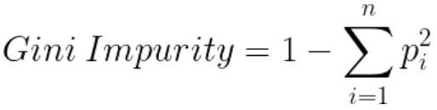
Gini Impurity
Gini impurity is used for splitting the nodes when the target variable is categorical.
GI = 1 - Gini
Gini says that if we pick 2 points at random then both the pts belong to the same class.
Lower the Gini Impurity, higher the purity of the node.

Slide 11
Steps to calculate Gini Impurity:
Calculate the gini impurity of each child node.
Calculate the gini impurity of each split as weighted average gini impurity of each child node.
Select the split with the lowest gini impurity.
Perform steps 1-3 until completely pure nodes are achieved.

